Slide 1
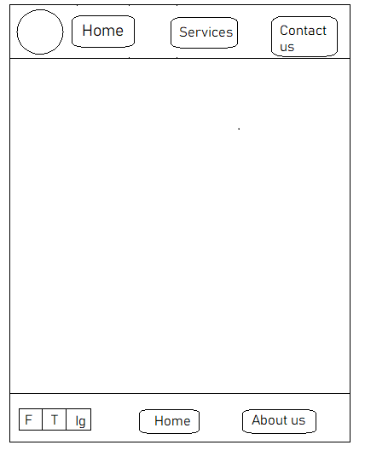


TEXT
TEXT ABOUT THE ABOUT US PAGE

